Slide 1
Implementing Quantum Pattern Matching
AP3421-PR Quantum Information Project
Aritra Sarkar & Naveen Kumar

Slide 2

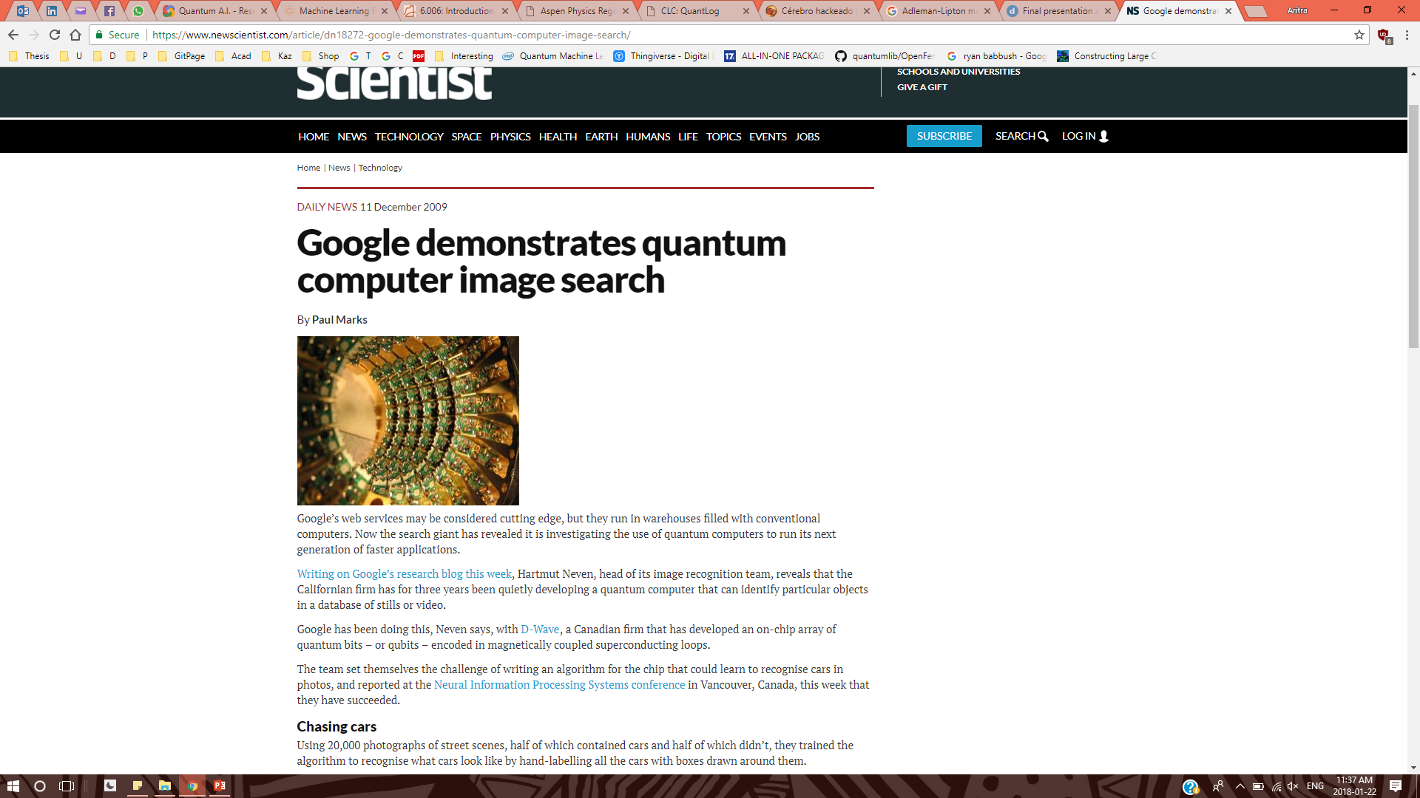

Motivation
Jigsaw Puzzles!!
… a trip down memory lane (90s kid et. al)
Pattern matching for big data in an exa-scale computer
Pattern matching: classification & analysis
Big data sources: social media, genes, LHC
Exa-scale device: GPU clusters

Slide 3
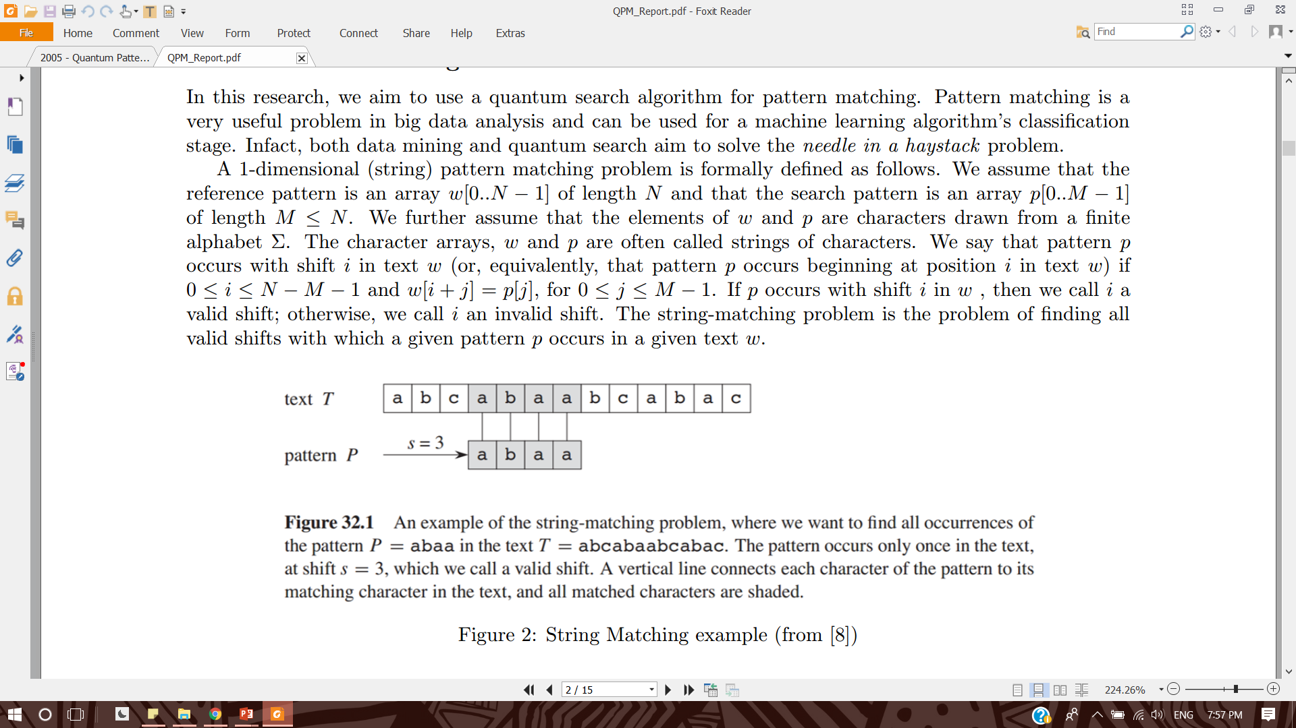
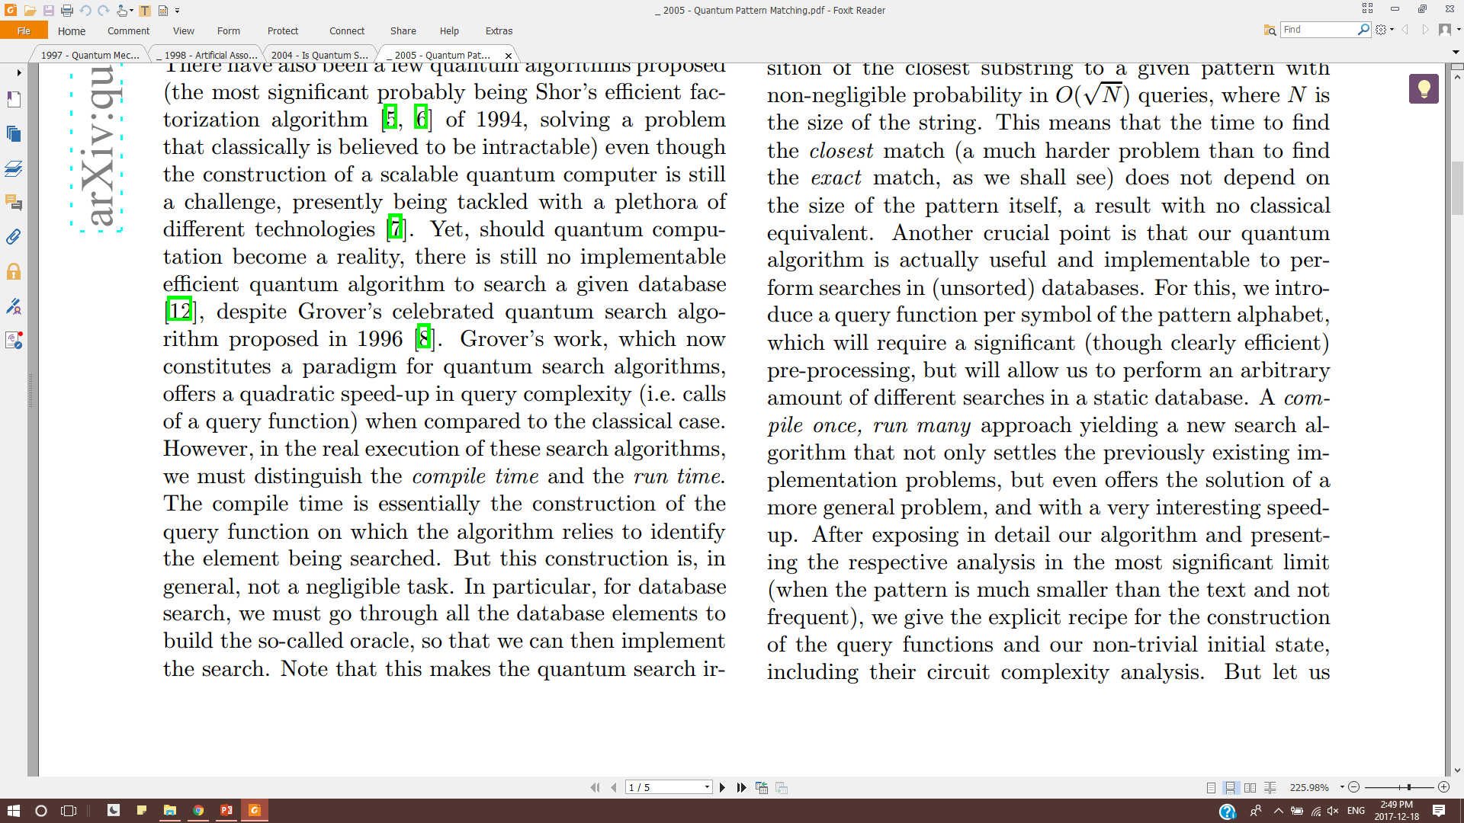
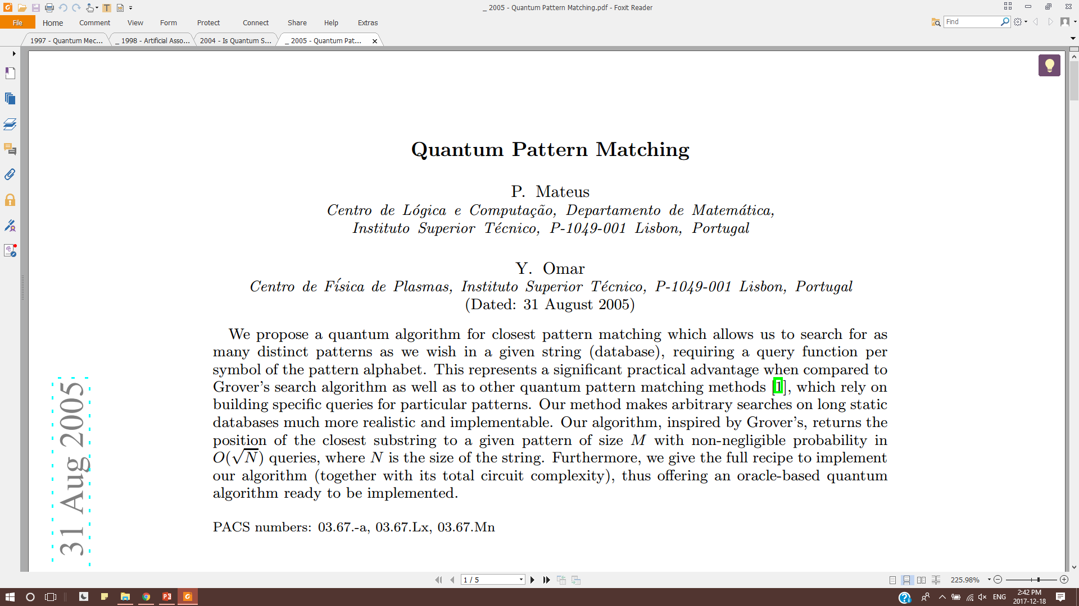
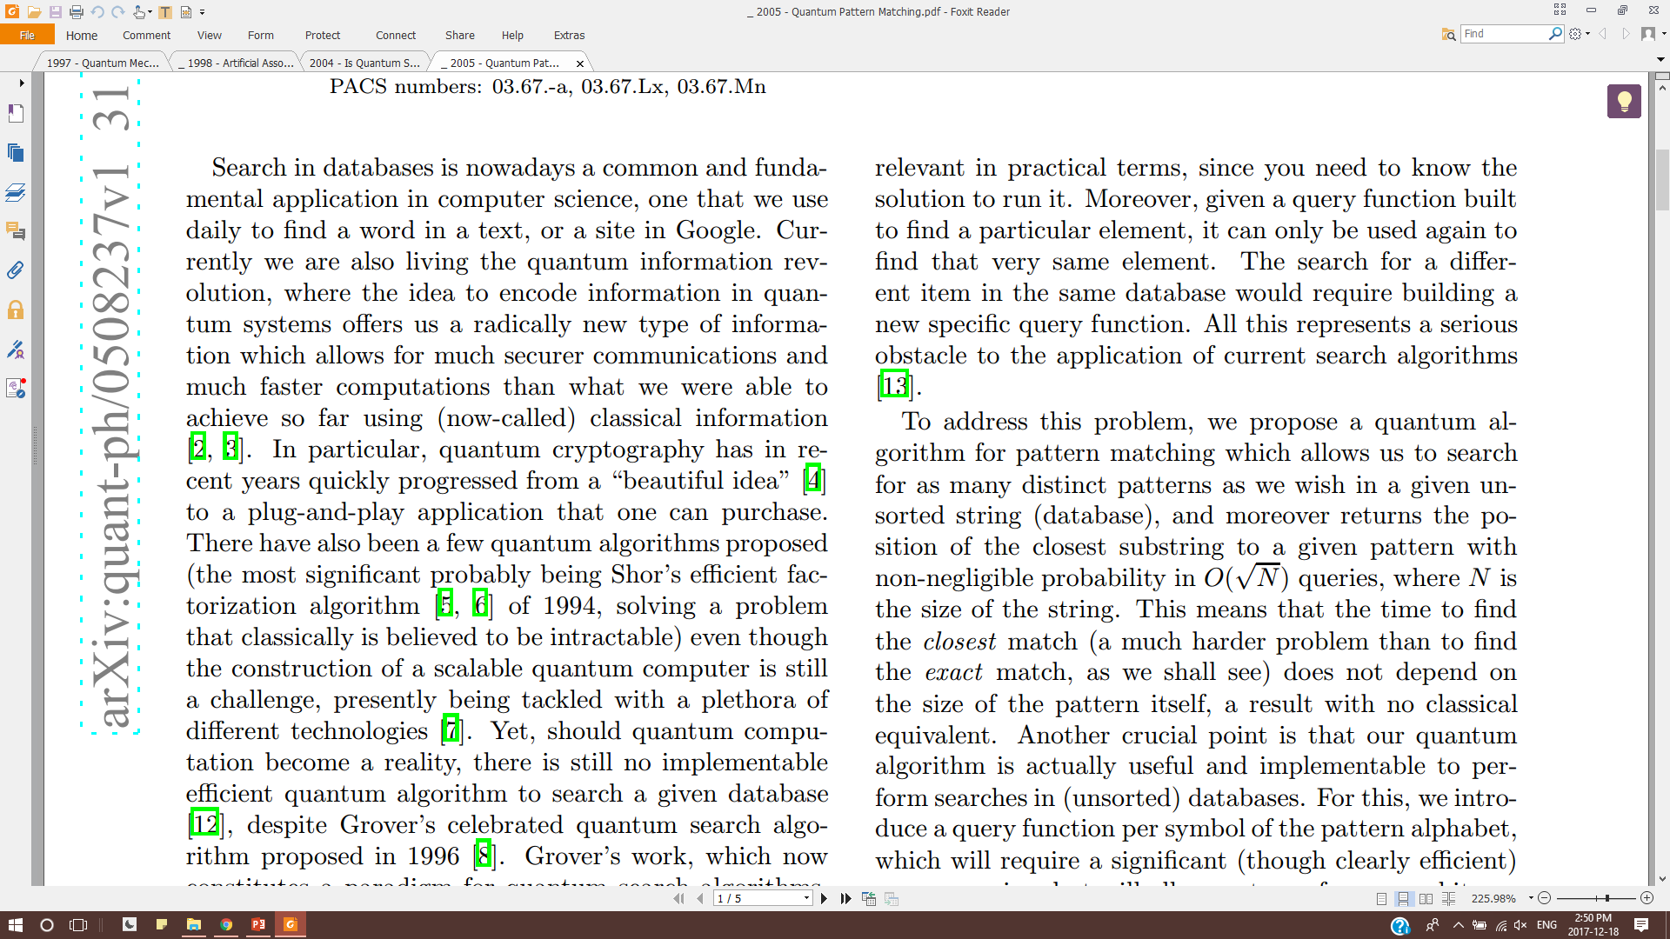
Pattern Matching

Slide 4
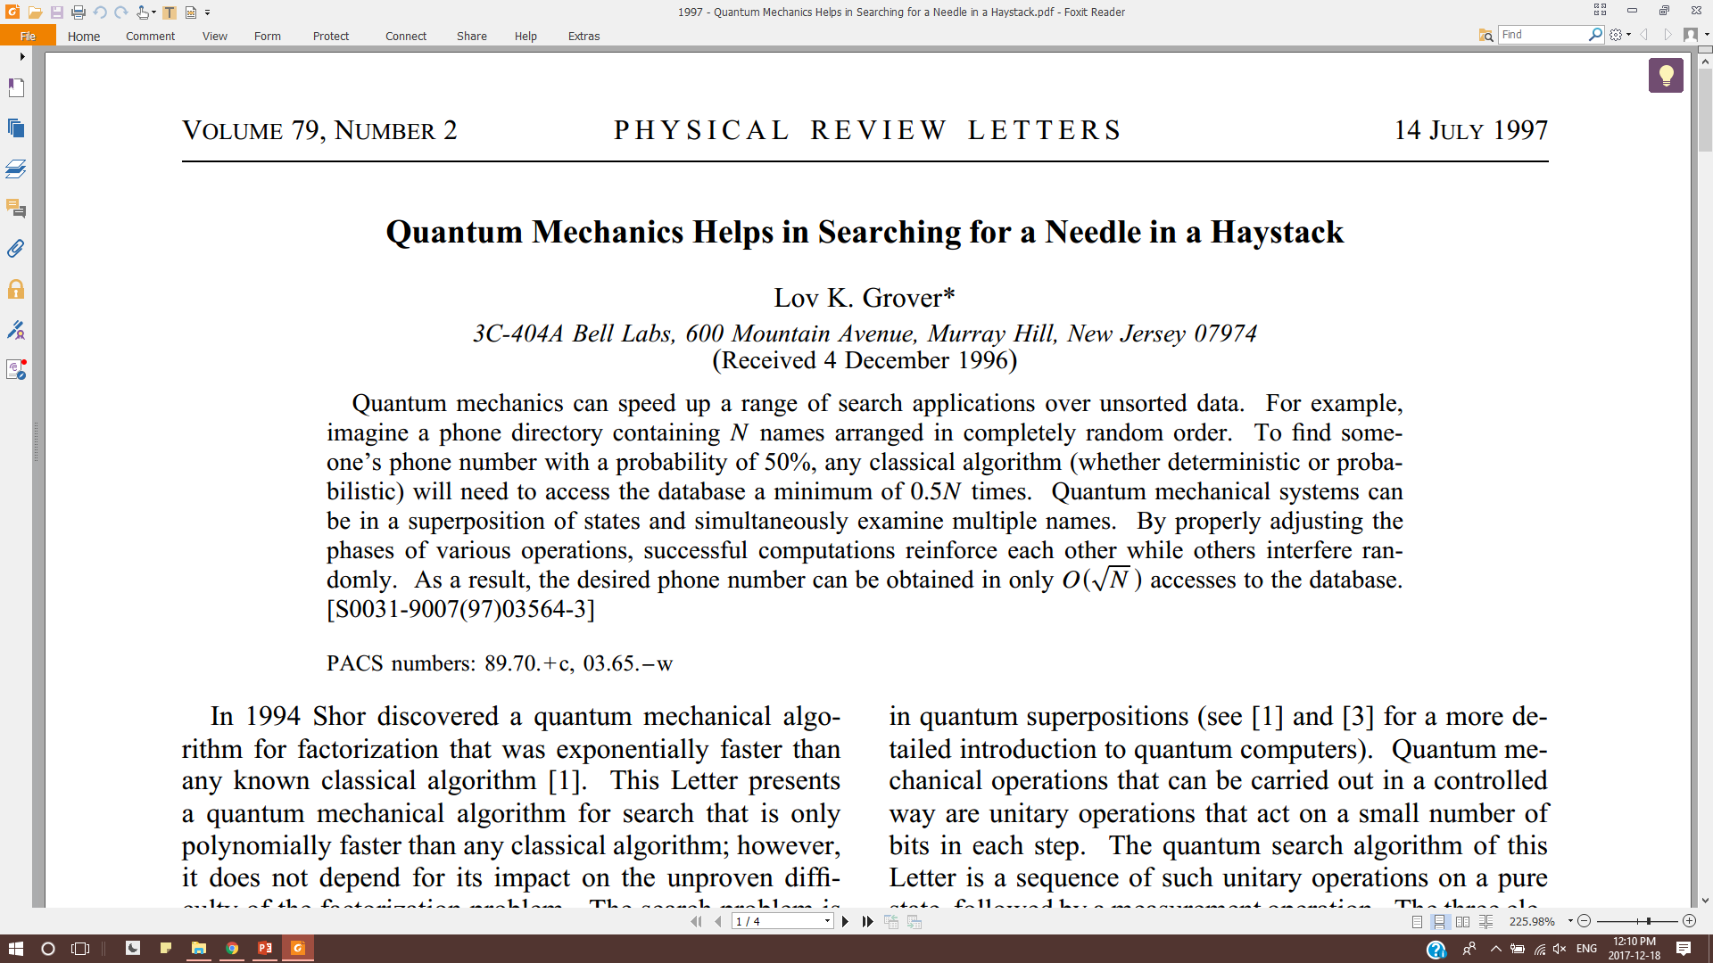
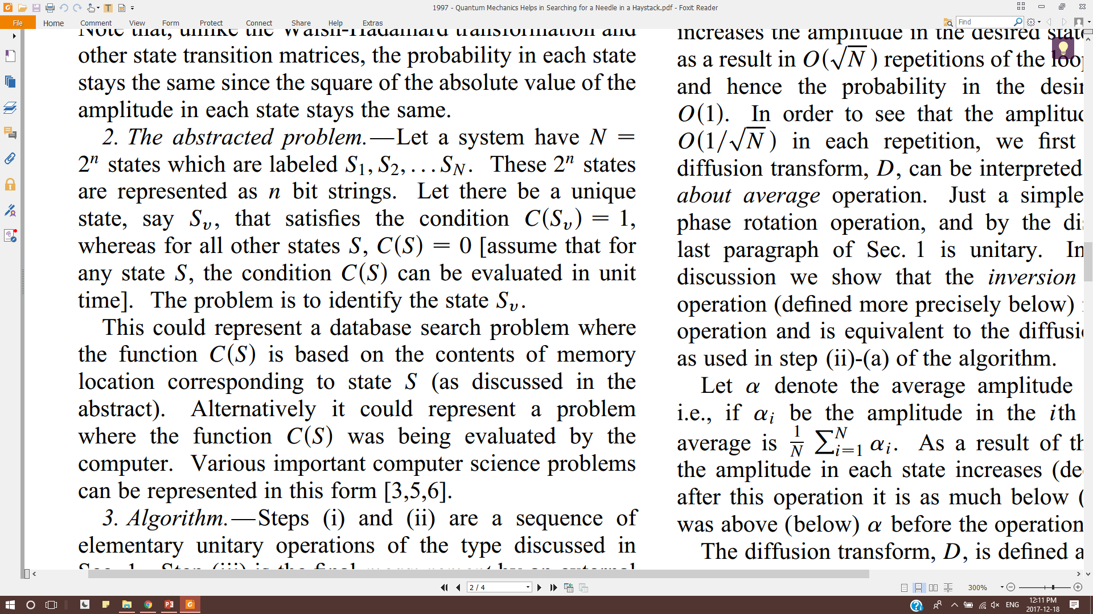
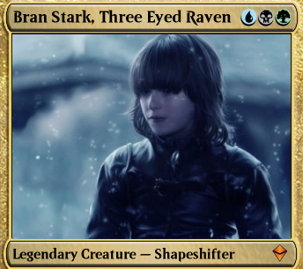
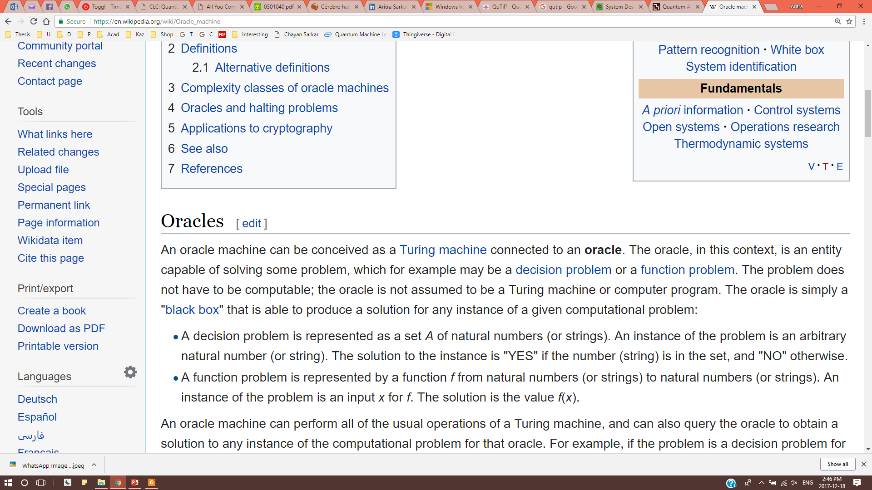
Oracles
Grover’s search
unstructured database
assumes existence of an Oracle
quadratic reduction in query complexity
What is an Oracle?
Learned
Introvert
Mystical
Fictional

Slide 5
Quantum Pattern Matching
|0>^{⊗n}
H^{⊗n}
Oracle
A.A.
ans
Depends on w:p relation
repeat √N times
w: Reference Pattern
p: Search Pattern
Σ: Alphabet
p
|0>^{⊗n}
Init
Oracle
A.A.
index
Depends on w

Slide 6
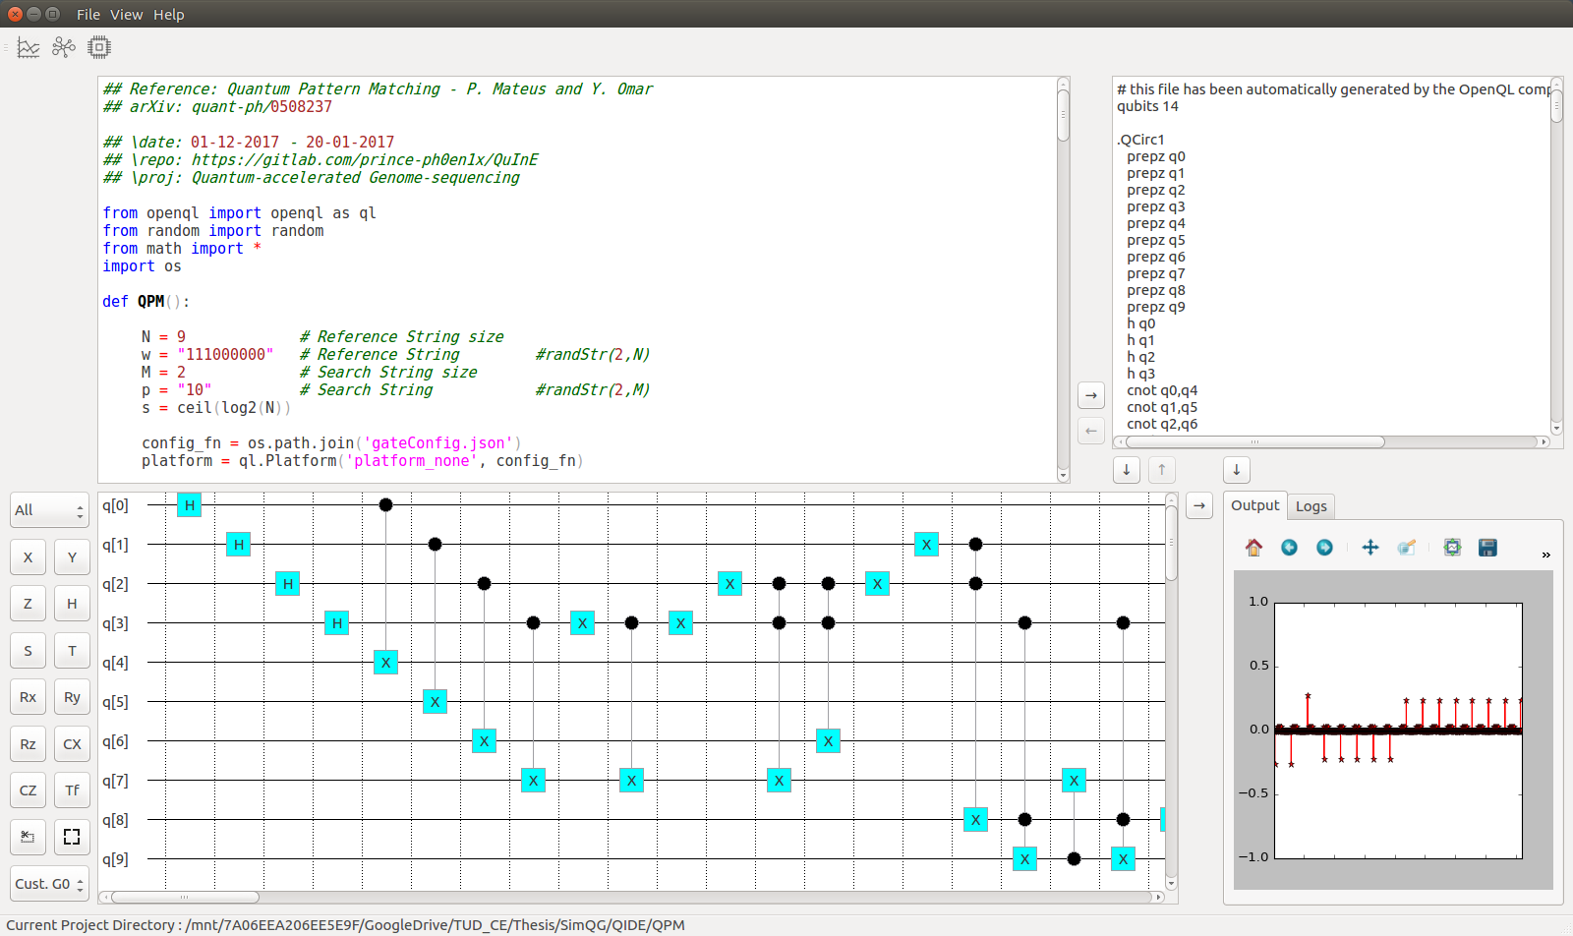
Tools
MATLAB
QuInE
OpenQL
QX simulator

Slide 7
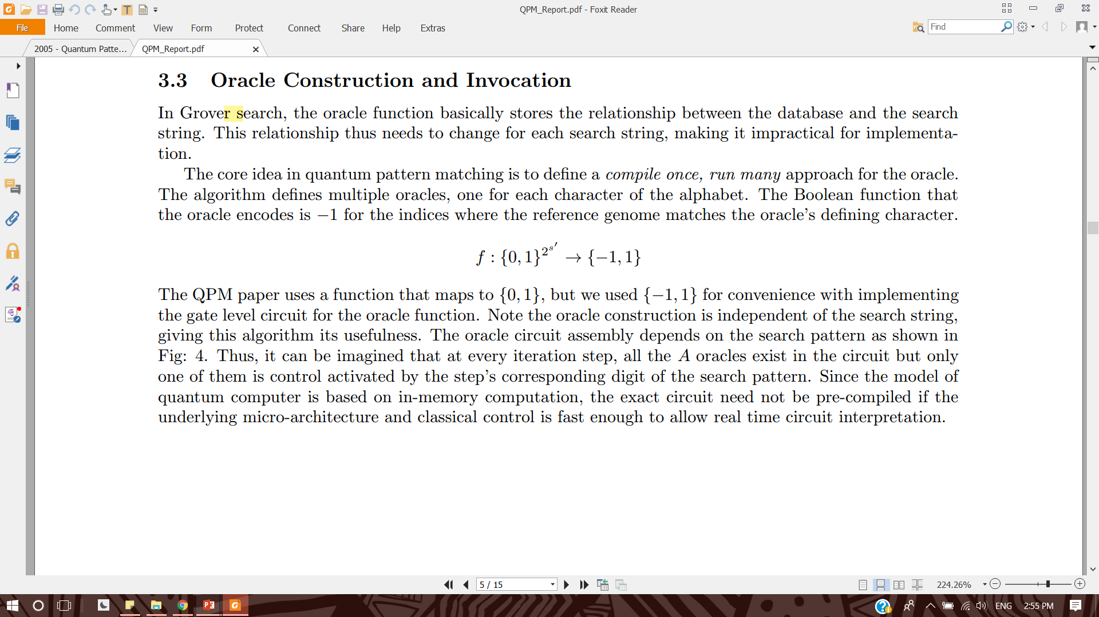
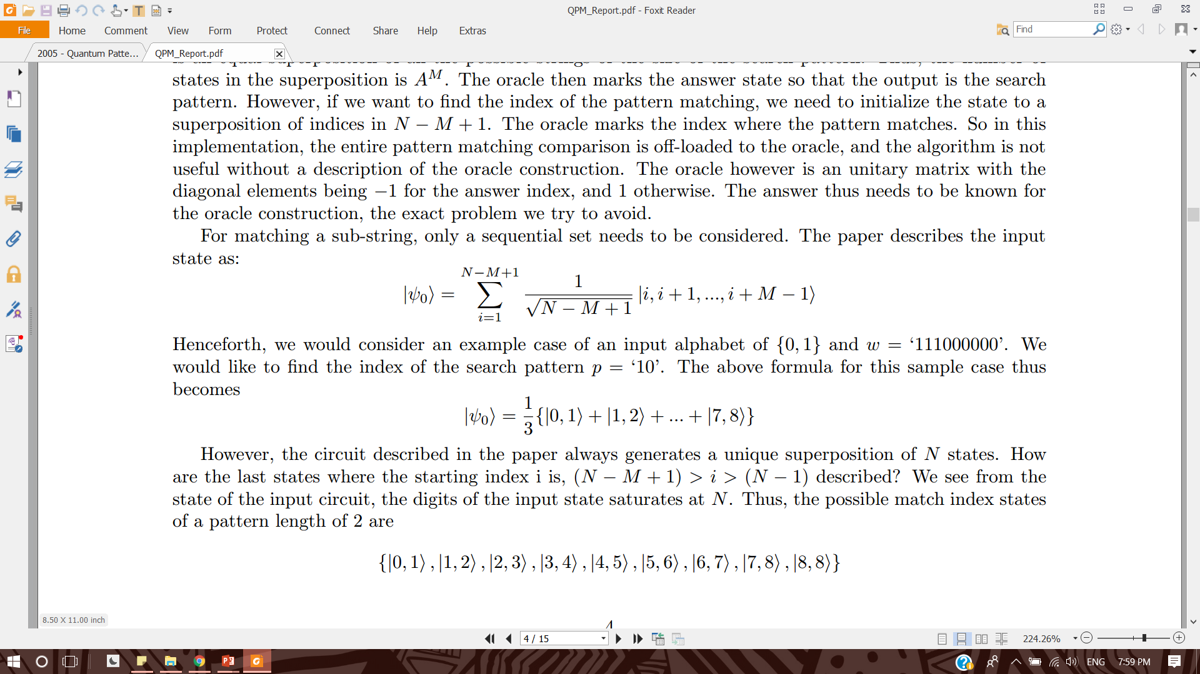
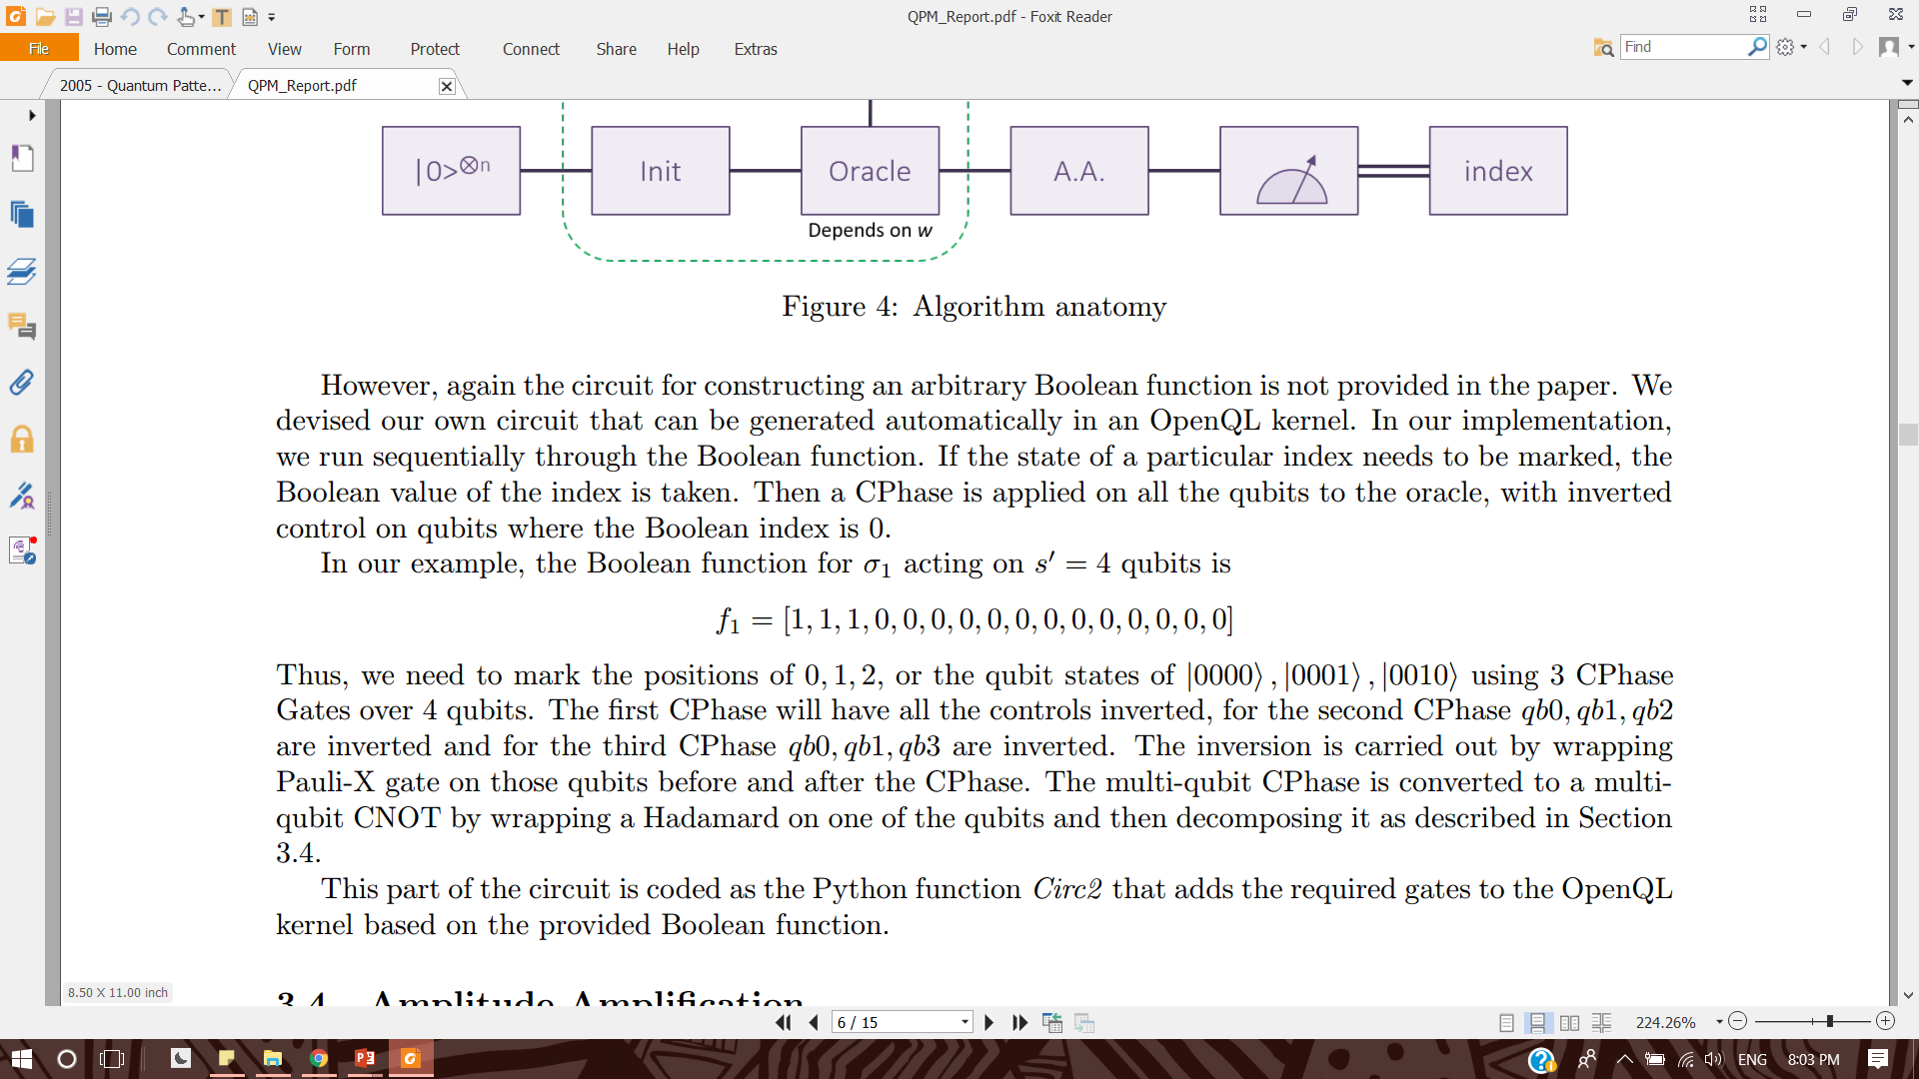
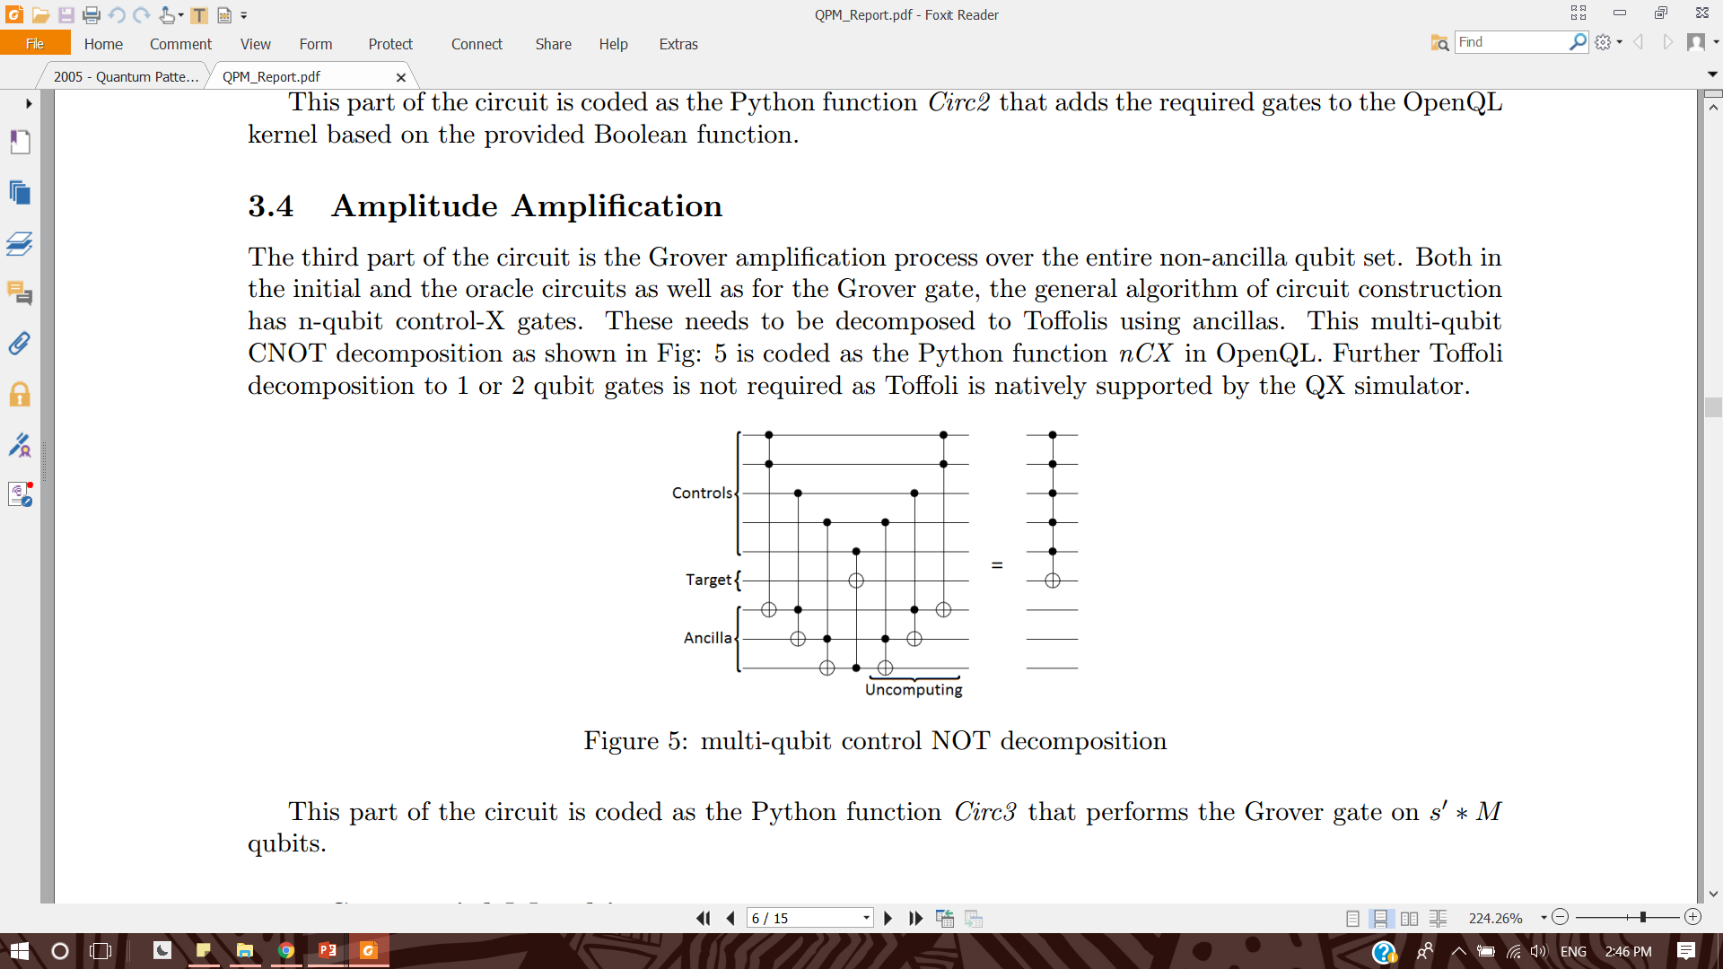
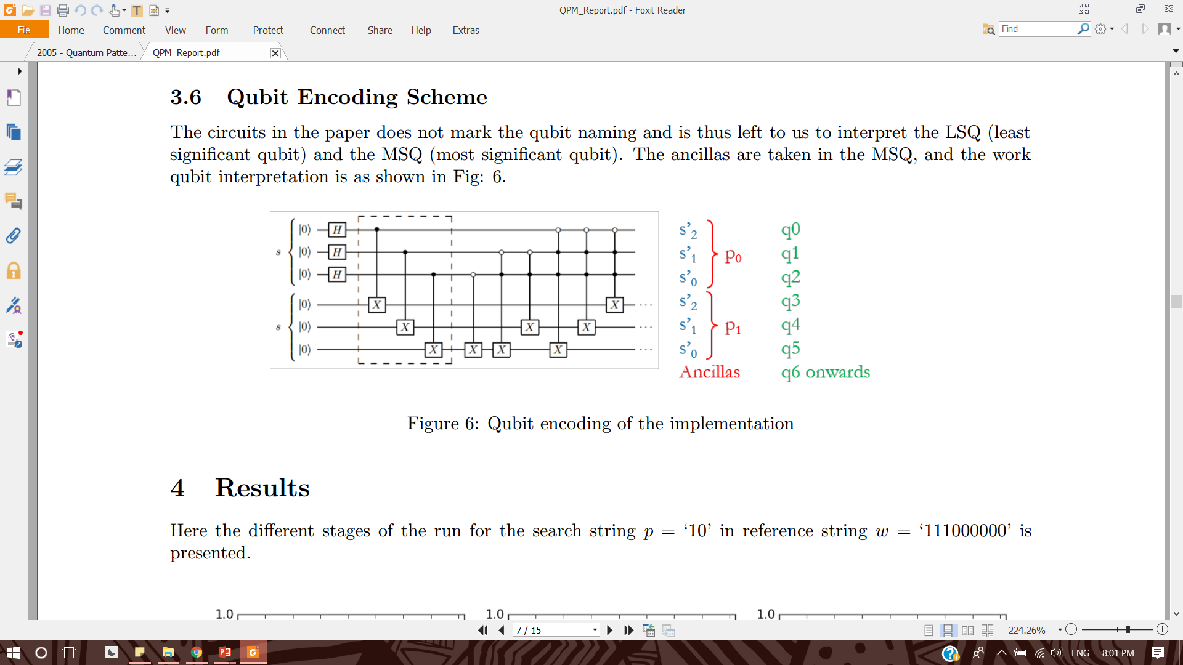
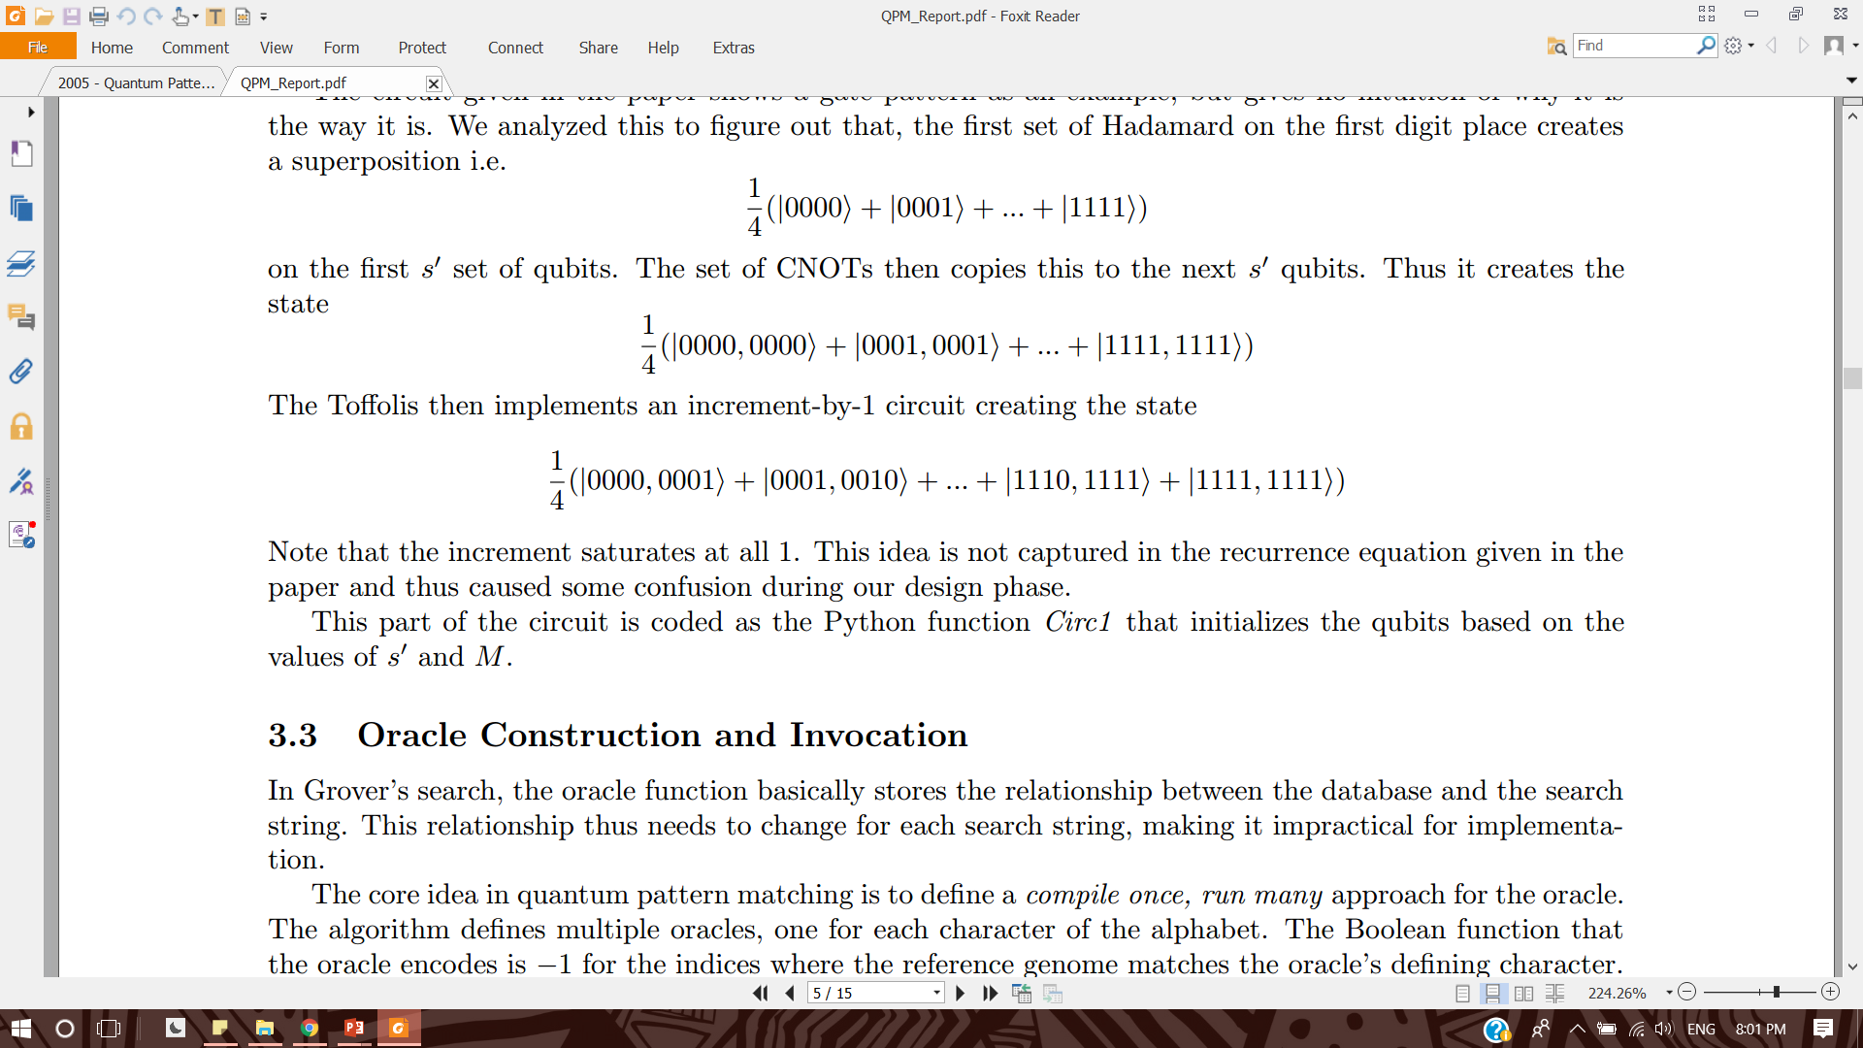
Algorithm
Initialize
Make/Call Oracles
Inversion about mean
111000000
Sequential copy and increment
Arbitrary Boolean function
If state of an index to be marked
Take Boolean value of Index
Apply CPhase on all s’ qubits
X Control on qubits with value = 0
Grover Gate on all s’*M qubits
Inversion about Mean
Amplitude Amplification

Slide 8
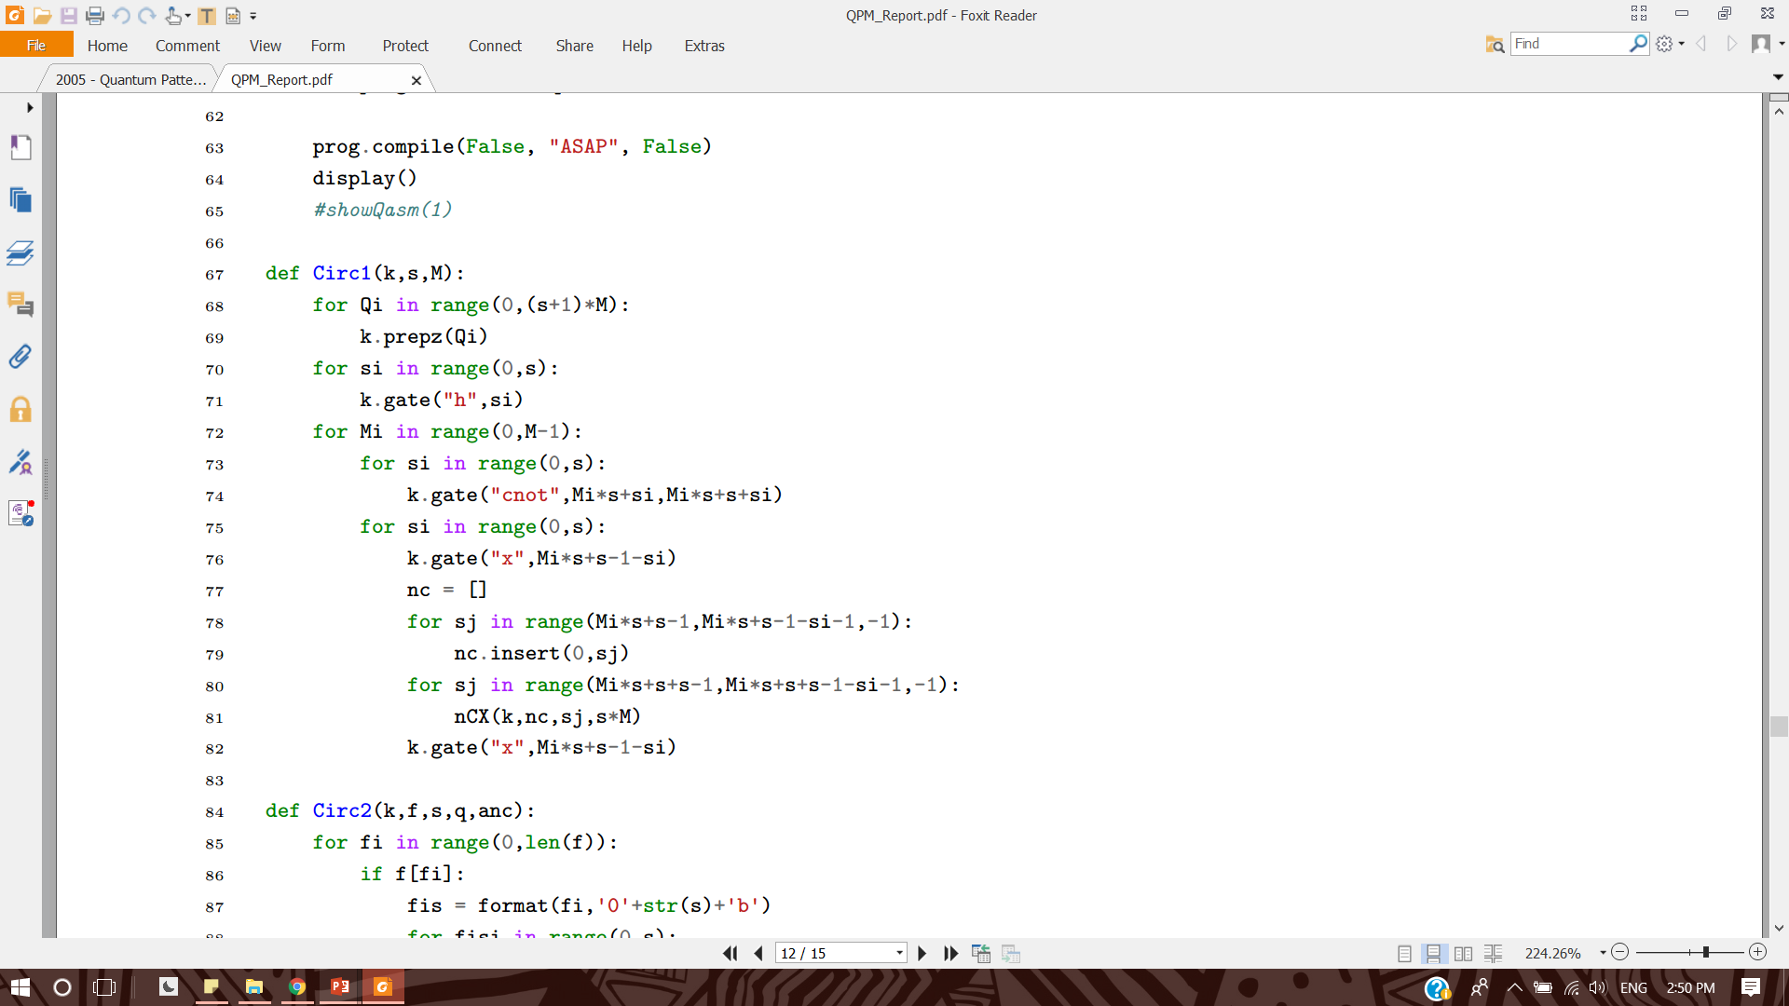
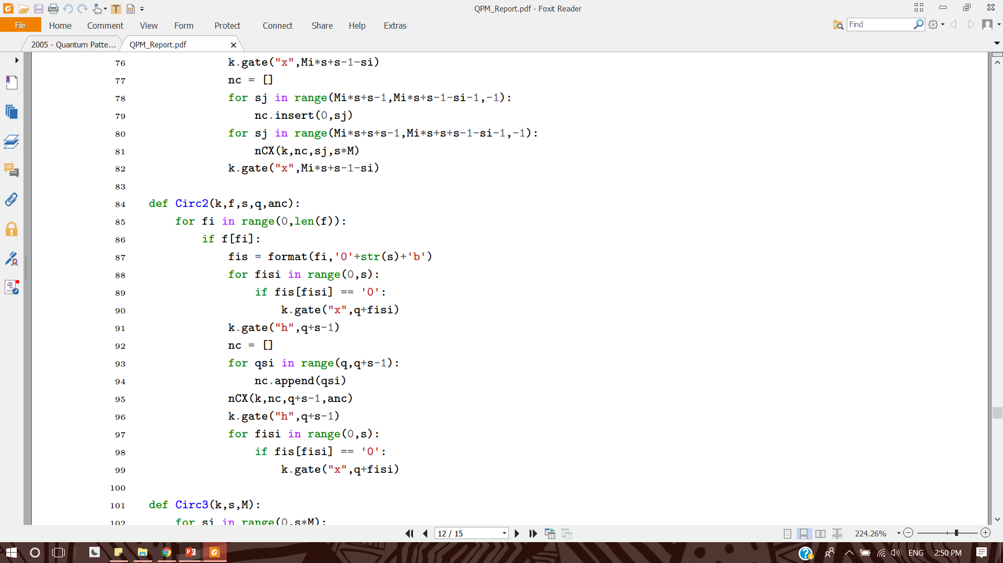
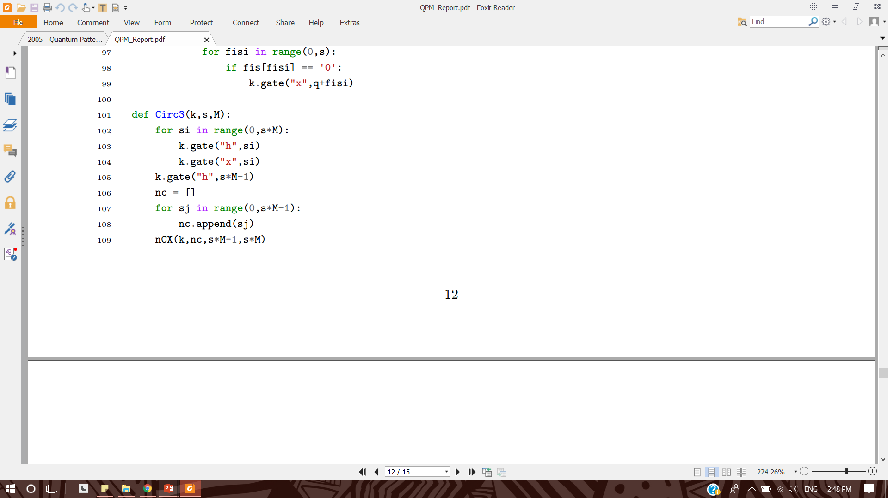
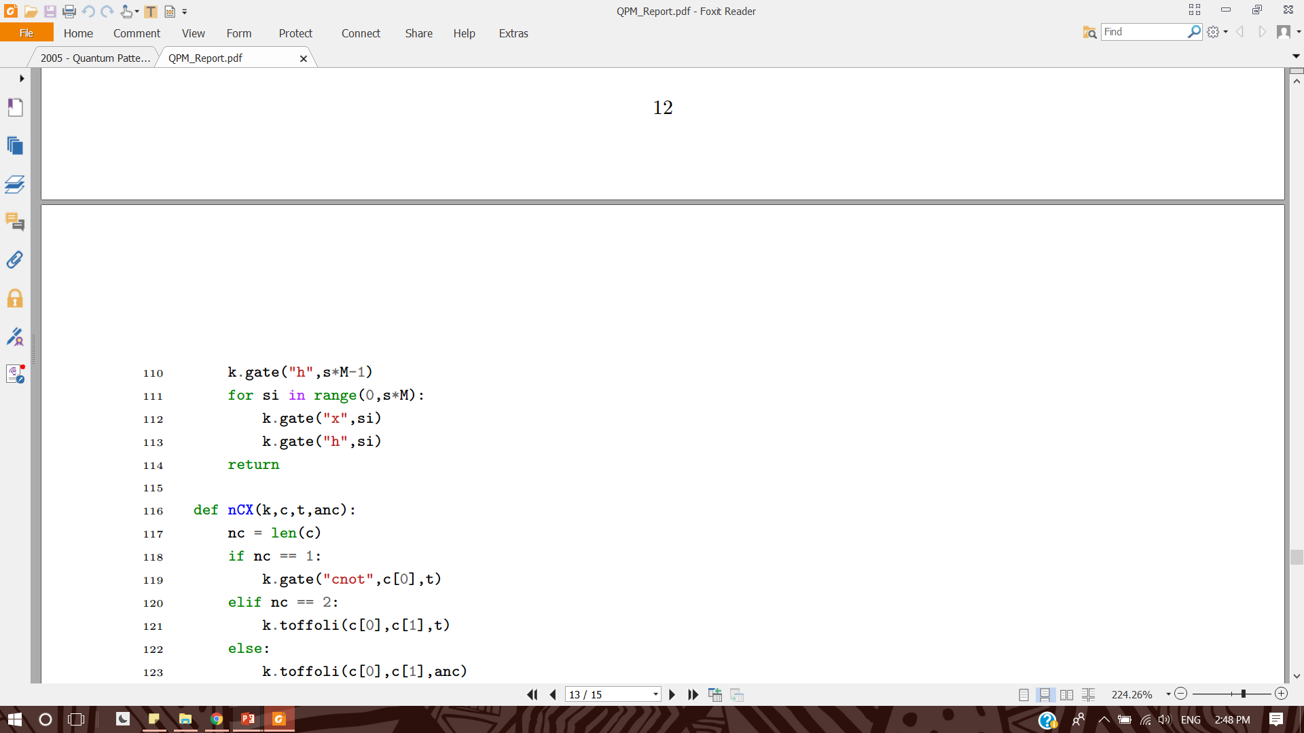
Kernels
Initialize
Make/Call Oracles
Inversion about mean

Slide 9
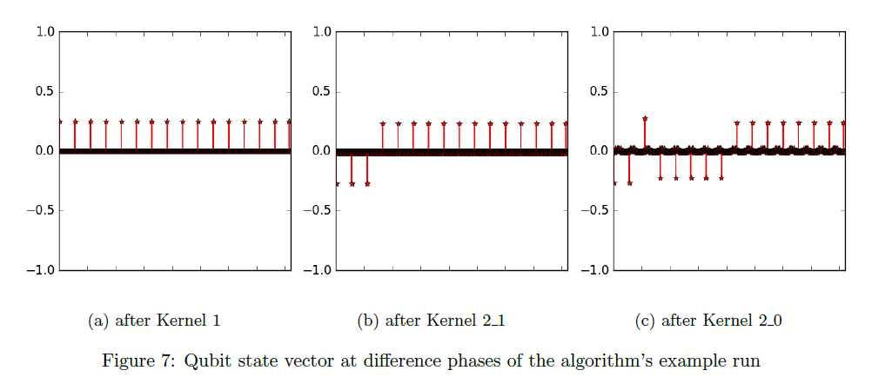
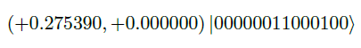
Results
Different stages of the run for the search string p = "10" in reference string w = "111000000"
0 1 2 3 4 5 6 7 8
3 2

Slide 10

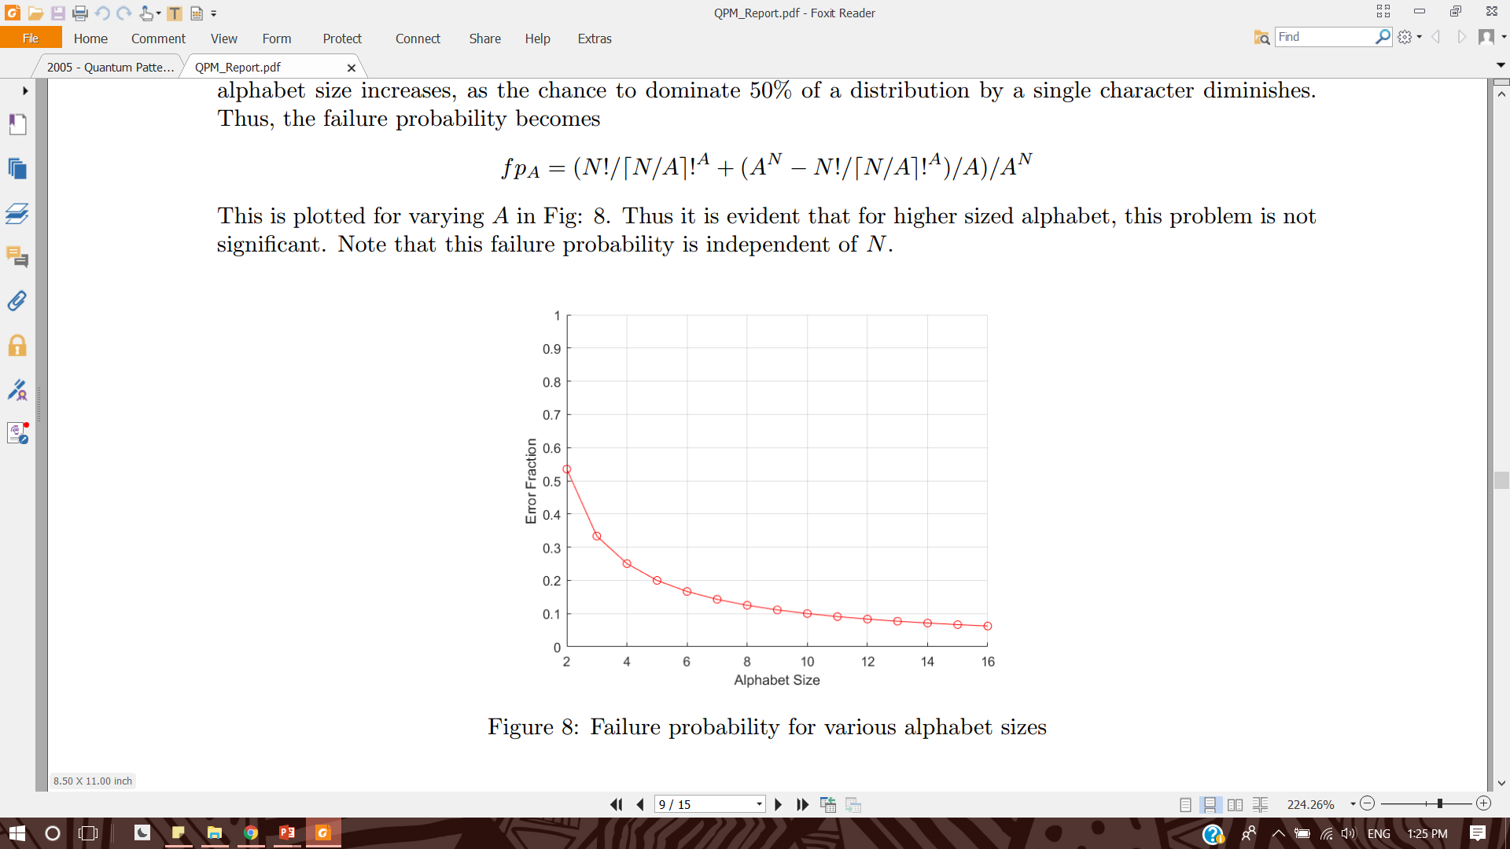
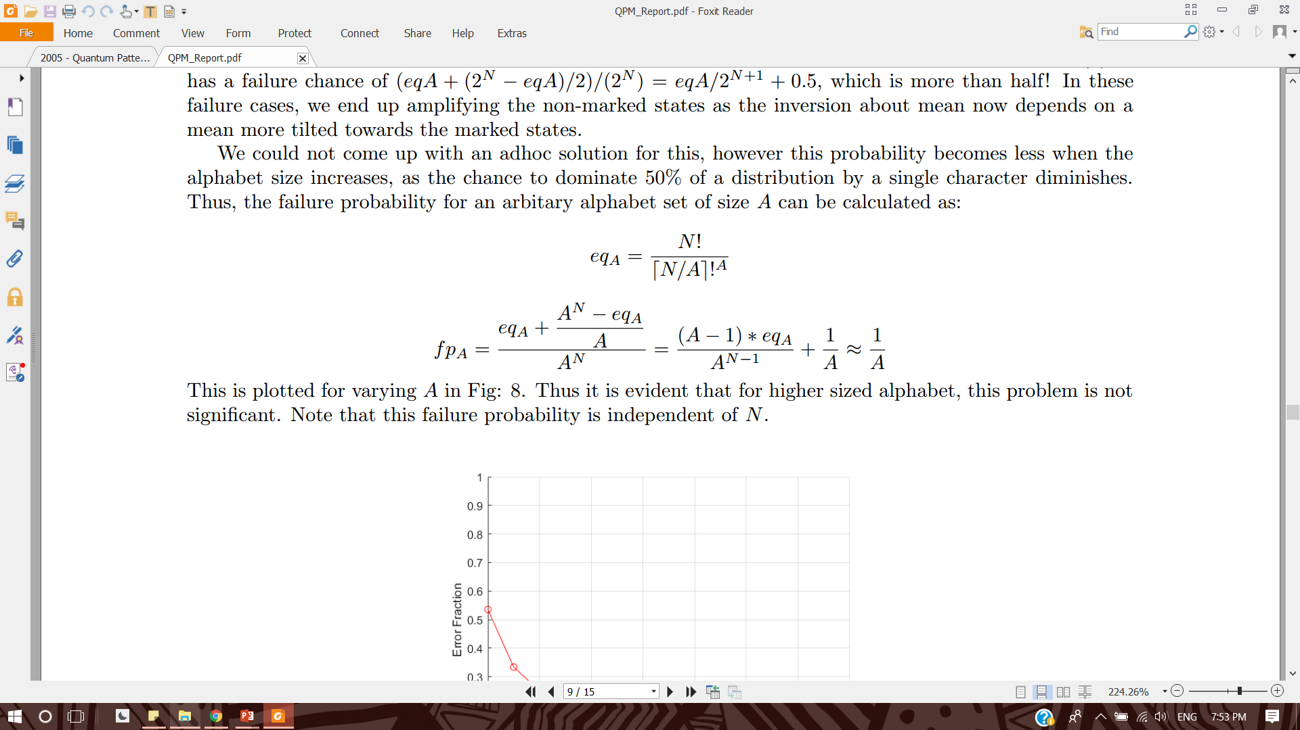

Future Work
Dimension
Quantum Machine Learning
Alphabet

Slide 11
Implementing Quantum Pattern Matching
AP3421-PR Quantum Information Project
Aritra Sarkar & Naveen Kumar

Slide 12
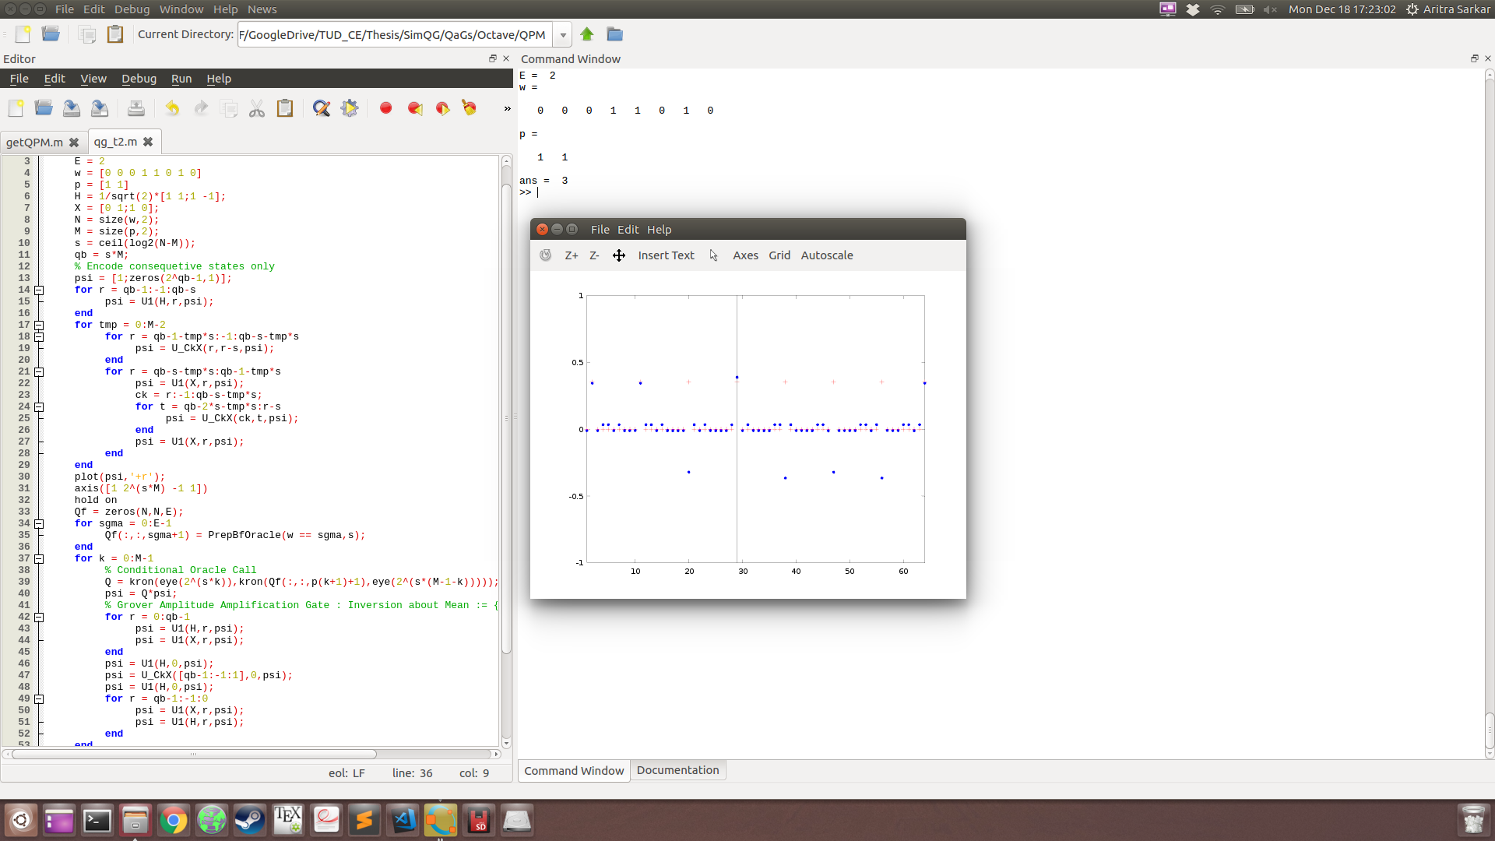
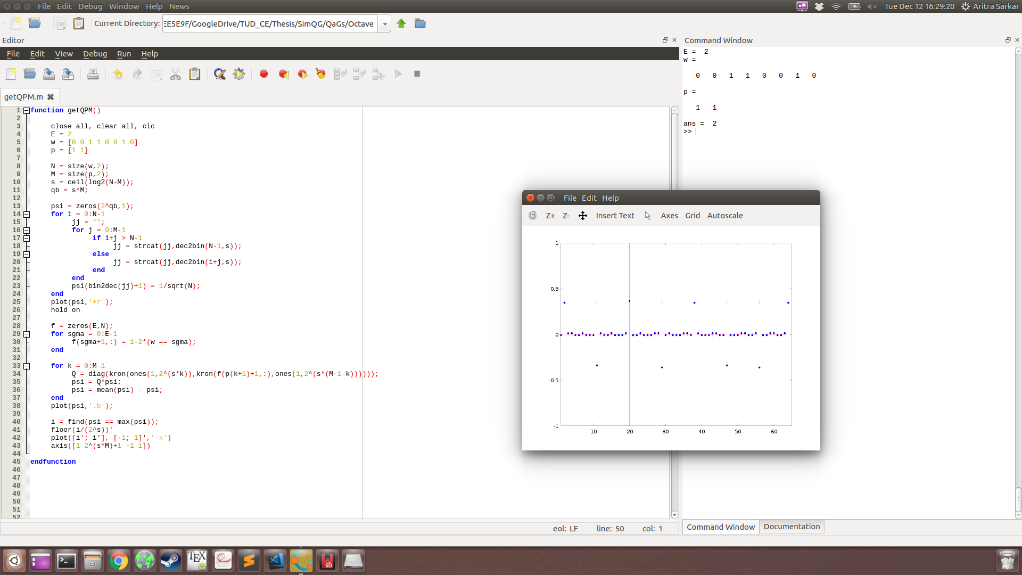
MATLAB

Slide 13
Initialization
Sequential copy and increment

Slide 14
Oracle call
Circuit for arbitrary Boolean function
If state of an index needs to be marked
Take Boolean value of Index
Apply CPhase on all s’ qubits
Inverted Control on qubits with Boolean value = 0

Slide 15
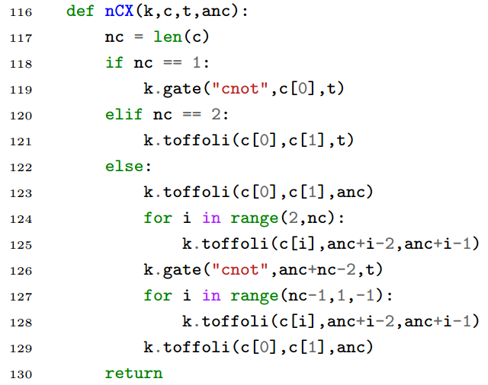
Amplitude amplification
Grover Gate on all s’*M qubits
Inversion about Mean

